Slide 1
Veeam Backup & Replication Update 4
SISPAQ

Slide 2
Veeam 가상화 백업 소개

Slide 3

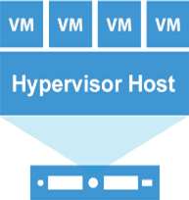




가상화 백업 컴포넌트
Data Transfer Scheme
Veeam backup server
Data Mover
service*
Data Mover
service
Source host
Veaam backup proxy
Veeam backup repository
* Veeam Data Mover service is also referred to as Veeam transport service.

Slide 4

Veeam Backup Proxy (VMware)
서버는 Veeam 백업 서버와 백업 저장소에 모두 액세스 할 수 있습니다.
여러 동시 작업의 성능을 최적화하려면 여러 개의 백업 프록시를 사용할 수 있습니다.
데이터를 오프 사이트 저장소로 이동하는 경우 프록시를 기본 사이트와 원격 사이트 모두에 배치하는 것이 좋습니다.
Veeam Backup & Replication이 프록시를 자동으로 선택하거나 명시 적으로 정의 할 수 있습니다.
각 세션은 프록시 서버가 디스크별로 선택됩니다.
Veeam backup
server
Data Mover
service
Data Mover
service
WAN
Source host
Backup proxy
Backup proxy
Backup repository

Slide 5
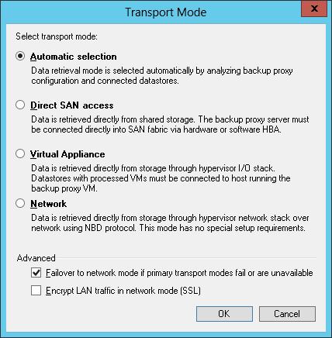
Transport Modes
Data Retrieval (VMware)
전송 모드는 프록시에서 Veeam 데이터 이동 서비스가 소스 호스트에서 VM 데이터를 검색하고 VM 데이터를 대상 대상에 쓰는 데 사용되는 방법입니다.
Backup Infrastructure > Backup Proxies
Proxy 선택
우클릭하여 Properties
Choose 클릭 후 Transport Mode

Slide 6
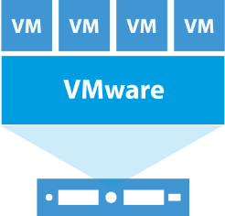
Transport Modes
Direct Storage Access (VMware)
A. Direct SAN Access
Benefits
Quickest processing mode
Least impact on production
Backup processing fully offloaded
LAN-free backup traffic
No impact on consolidation ratio
Considerations
Supports block storage only
iSCSI: physical and virtual backup proxy servers both supported
Physical backup proxy server requirement for FC SAN
Consider repurposing older servers
Might be hard for beginners to setup
Veeam backup server
Source ESX(i) host
2
3
1
4
5
Production
storage
VMware backup proxy
Backup repository
Notes:
The Direct SAN Access transport mode is recommended for VMs with disks located on shared VMFS SAN LUNs that are connected to ESX(i) hosts via FC or iSCSI.
Data retrieval in the Direct SAN Access transport mode is as follows:
The backup proxy sends a request to the ESX(i) host to locate the necessary VM on the datastore.
The ESX(i) host locates the VM and retrieves metadata about the layout of VM disks on the storage (physical addresses of data blocks).
The ESX(i) host sends metadata to the backup proxy via network mode.
The backup proxy uses metadata to copy VM data blocks directly from the storage via the SAN.
The backup proxy processes copies data blocks and sends them to the target.
You can use Direct SAN Access transport mode for all operations in which the backup proxy is engaged, including VM restore.
Note: There are a number of requirements and limitations for Direct SAN access mode. You are welcome to check them out in our user guide.

Slide 7
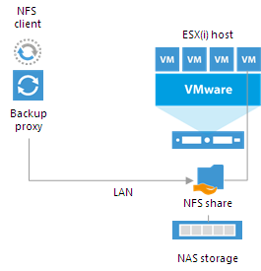
Transport Modes
Direct Storage Access (VMware)
B. Direct NFS Access
Benefits
Recommended transport mode for VMs whose disks are located on NFS datastores
Veeam Backup & Replication bypasses the ESX(i) host and reads/writes data directly from/to NFS datastores
VM data still travels over the LAN but there is no load on the ESX(i) host
Considerations
Cannot be used for VMs that have at least one snapshot
Cannot be used VMware tools quiescence option is enabled
If a VM has some disks that cannot be processed in the Direct NFS access mode, Veeam Backup & Replication processes all VM disks in the Network mode
Notes:
The Direct NFS access transport mode is a recommended transport mode for VMs with disks located on NFS datastores.
Data backup in the Direct NFS access transport mode is as follows:
The backup proxy sends a request to the ESX(i) host to locate a VM on the NFS datastore.
The ESX(i) host locates the VM.
The ESX(i) host retrieves metadata about the layout of VM disks on the storage (physical addresses of data blocks).
The ESX(i) host sends metadata to the backup proxy.
The backup proxy uses metadata to copy VM data blocks directly from the NFS datastore over the LAN.
The backup proxy processes copied data blocks and sends them to the target over the LAN.
You can use Direct NFS Access transport mode for all operations in which the backup proxy is engaged, including VM restore.
Note: There are a number of requirements and limitations for Direct NFS access mode. You are welcome to check them out in our user guide.

Slide 8

Transport Modes
Virtual Appliance Mode (VMware)
Benefits
Easy to setup
Fast data transfers with any storage
Uses existing Windows VMs (save on licensing)
Allows for 100% virtual deployment
Uses the SCSI/SATA hot-add capability of ESXi hosts
Considerations
Not as mature as other modes
Can affect your consolidation ratio
Can be slow
Veeam backup server
VMware backup proxy
Source
ESXi host
ESXi host with a virtual backup proxy
Backup repository
Notes:
In the Virtual Appliance mode, Veeam Backup & Replication uses the VMware SCSI HotAdd capability that allows attaching devices to a VM while the VM is running.
During backup, replication or restore disks of the processed VM are attached to the backup proxy. VM data is retrieved or written directly from/to the datastore, instead of going through the network.
The process of data retrieval in the Virtual Appliance is as follows:
The backup proxy sends a request to the ESX(i) host to locate the necessary VM on the datastore.
The ESX(i) host locates the VM.
Veeam Backup & Replication triggers VMware vSphere to create a VM snapshot.
VM disks are attached (hot-added) to the backup proxy.
Veeam Backup & Replication reads data directly from disks attached to the backup proxy.
When the VM processing is complete, VM disks are detached from the backup proxy and the VM snapshot is deleted.
You can use the Virtual appliance transport mode for all operations in which the backup proxy is engaged, including VM restore.
Note: There are a number of requirements and limitations for Direct SAN access mode. You are welcome to check them out in our user guide.

Slide 9
Transport Modes
Network Mode (VMware)
Benefits
Easy to setup
Any storage
Quick to start data transfer
Fast, with 10Gb Ethernet
Considerations
Painfully low performance on 1Gb Ethernet
Leverages ESXi management interface
Slow on ESX 4.0
Veeam backup server
Source ESX(i) host
2
3
1
4
Production
storage
VMware backup proxy
Backup repository
Notes:
The Network mode can be used with any infrastructure configuration. In this mode, data is retrieved via the ESX(i) host over the LAN using the Network Block Device protocol (NBD).
The process of data retrieval in Network mode includes the following steps:
The backup proxy sends a request to the ESX(i) host to locate the necessary VM on the datastore.
The ESX(i) host locates the VM on the datastore.
VM data blocks are copied from the production storage and sent to the backup proxy over the LAN.
The backup proxy sends the data to target.
Note: You can instruct Veeam Backup & Replication to switch to the Network transport mode and transfer VM data over the LAN if the primary transport mode is inaccessible.

Slide 10
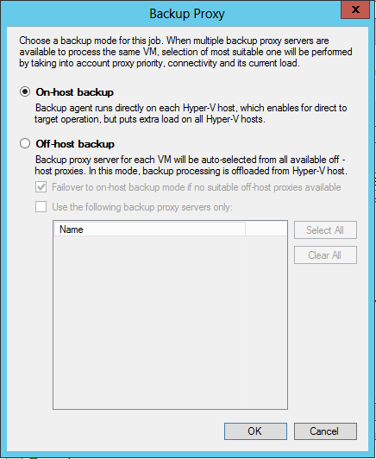
백업 Modes
Hyper-V 구성
Backup & Replication > Jobs
backup job 선택
우클릭 Edit
Proxy 선택
Storage 선택
Choose 클릭 후 Backup proxy

Slide 11
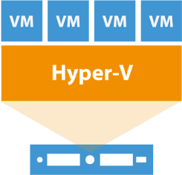

Backup Modes
On-host Backup Mode (Hyper-V)
Benefits
Easy and out-of-the-box
No need to utilize additional host
Good for small infrastructures
Considerations
Production host CPU usage
Network overhead on the host system
Veeam backup server
Data Mover
service
Source
Hyper-V host
Data Mover
service
Volume
Shared storage
Backup
repository
Volume
snapshot
Notes:
During on-host backup, VM data is processed on the source Hyper-V host where the VMs you want to back up or replicate reside.

Slide 12
Backup Modes
Off-host Backup Mode (Hyper-V)
Benefits
Fast
No impact on host CPU usage or network performance
Considerations
Extra physical machine
Source host and proxy should have the same OS version
To create and manage volume shadow copies on the shared storage, you must install a VSS hardware provider
Veeam backup
server
Source
Hyper-V host
Data Mover
service
Data Mover
service
Volume
Shared storage
Off-host
backup proxy
Backup
repository
Volume
snapshot
Notes:
In the off-host backup mode, backup processing is shifted from the source Hyper-V host to a dedicated machine — an off-host backup proxy.
Important! If you plan to perform off-host backup for a Hyper-V cluster with CSV, make sure you deploy an off-host backup proxy on a host that is NOT a part of a Hyper-V cluster.
When a volume snapshot is created, this snapshot has the same LUN signature as the original volume. Microsoft Cluster Services do not support LUNs with duplicate signatures and partition layouts. For this reason, volume snapshots must be transported to an off-host backup proxy outside the cluster. If the off-host backup proxy is deployed on a node of a Hyper-V cluster, a duplicate LUN signature will be generated, and the cluster will fail during backup or replication.

Slide 13
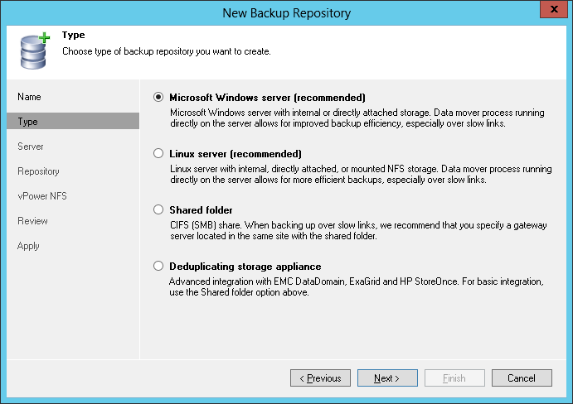
Veeam Backup Repository
When adding a repository, you have to choose its type:
Notes:
A backup repository is a location used by Veeam Backup & Replication jobs to store backup files. Technically, a backup repository is a folder on the backup storage.
By assigning different repositories to jobs and limiting the number of parallel jobs for each one, you can balance the load across your backup infrastructure.

Slide 14
Veeam Backup Repository
Repository Type | Storage Type | Data Processing
Windows server | A local disk, directly attached disk-based storage, or iSCSI/FC SAN LUN in case the server is connected into the SAN fabric | Veeam data mover service is deployed when server is added to UI
Linux server | A local disk, directly attached disk-based storage (such as a USB hard drive), NFS share, or iSCSI/FC SAN LUN in case the server is connected into the SAN fabric | Veeam data mover service is deployed when a job addressing this repository is launched
CIFS (SMB) share | NAS file share | Data transfer is done through the Veeam data mover service on the gateway server (proxy)
Deduplicating storage appliance | EMC Data Domain ExaGrid HP StoreOnce | Data transfer is done through the Veeam data mover service on the gateway server (proxy)
Notes:
In the Veeam backup infrastructure, you can use one of the four repository types listed on the slide.

Slide 15
VMware Vsphere Backup 구성
Microsoft Hyper V Backup 구성
VMware, Hyper – V Backup Job 생성
VMware, Hyper – V Backup Job 실행
VMware, Hyper – V Backup Restore
Replication - 구성
SureBackup - 구성

Slide 16
VMware Vsphere Backup

Slide 17
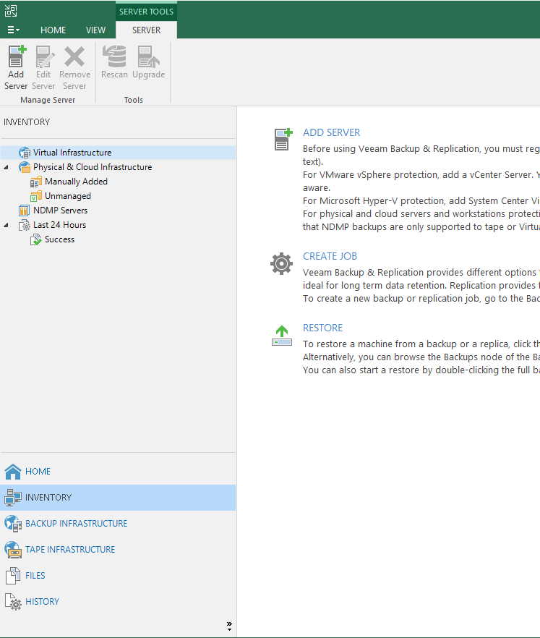
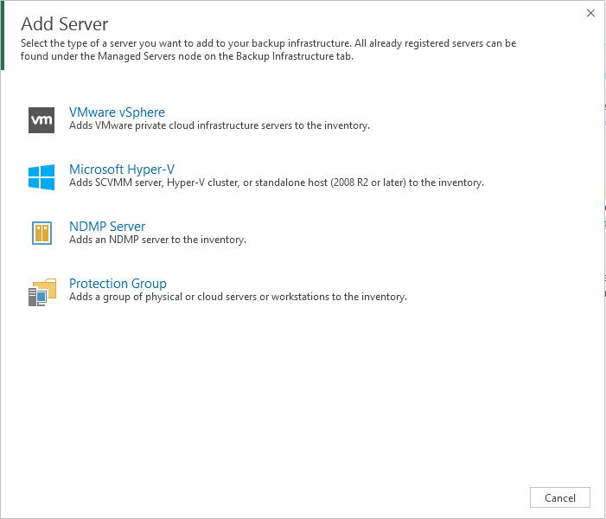
1. VMware Vsphere Backup
백업 Host 추가

Slide 18
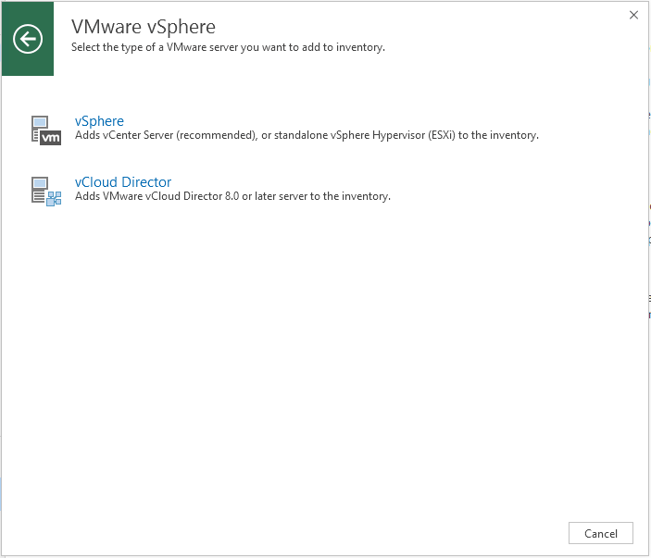
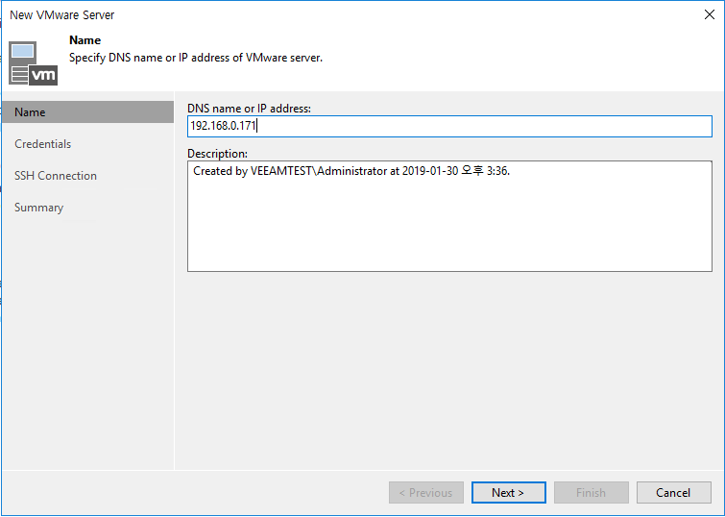
1. VMware Vsphere Backup
백업 Host 추가
IP 입력
Vcenter or ESXi ip

Slide 19
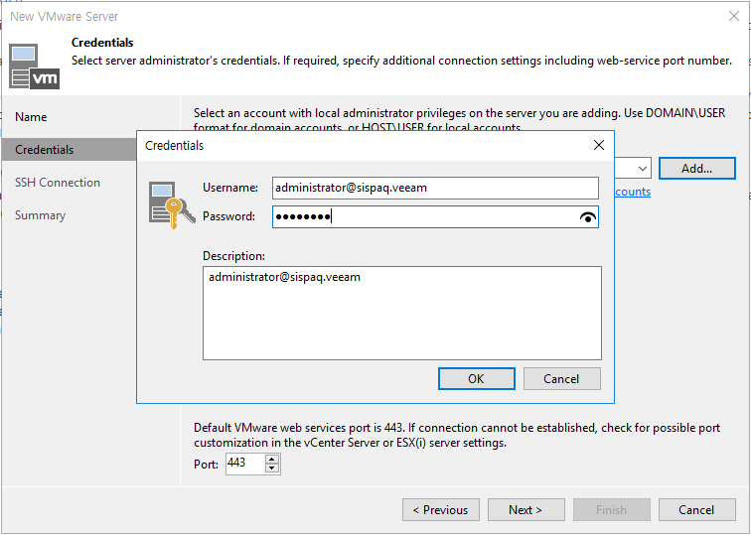
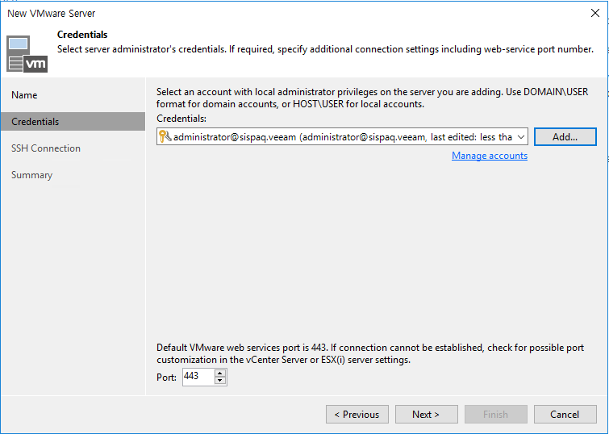
1. VMware Vsphere Backup
계정 정보 입력
Vcenter or MGMT

Slide 20
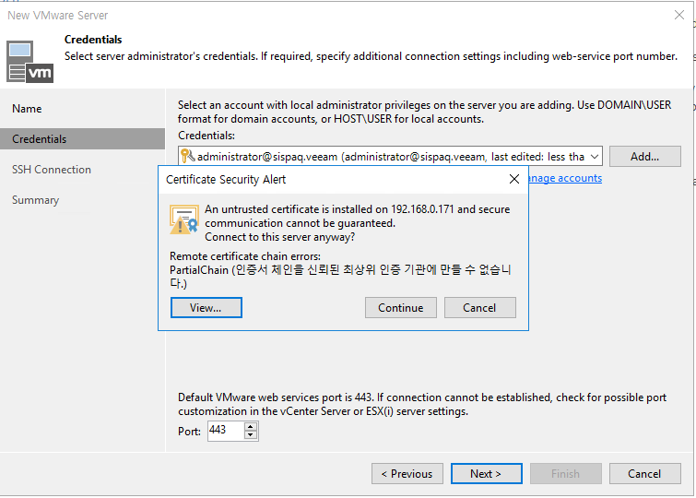
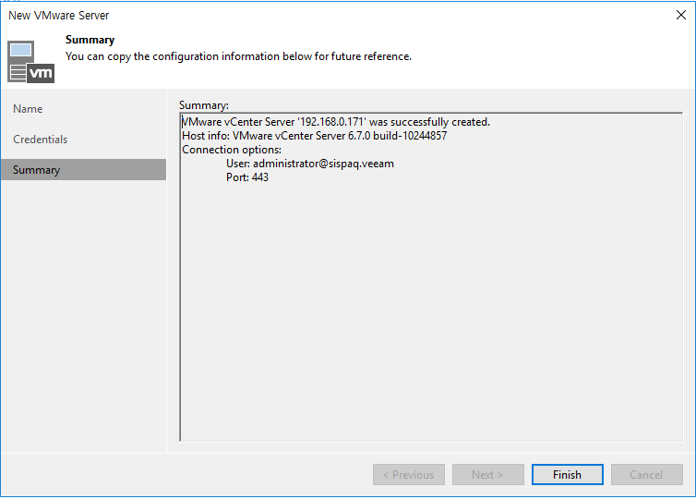
1. VMware Vsphere Backup

Slide 21
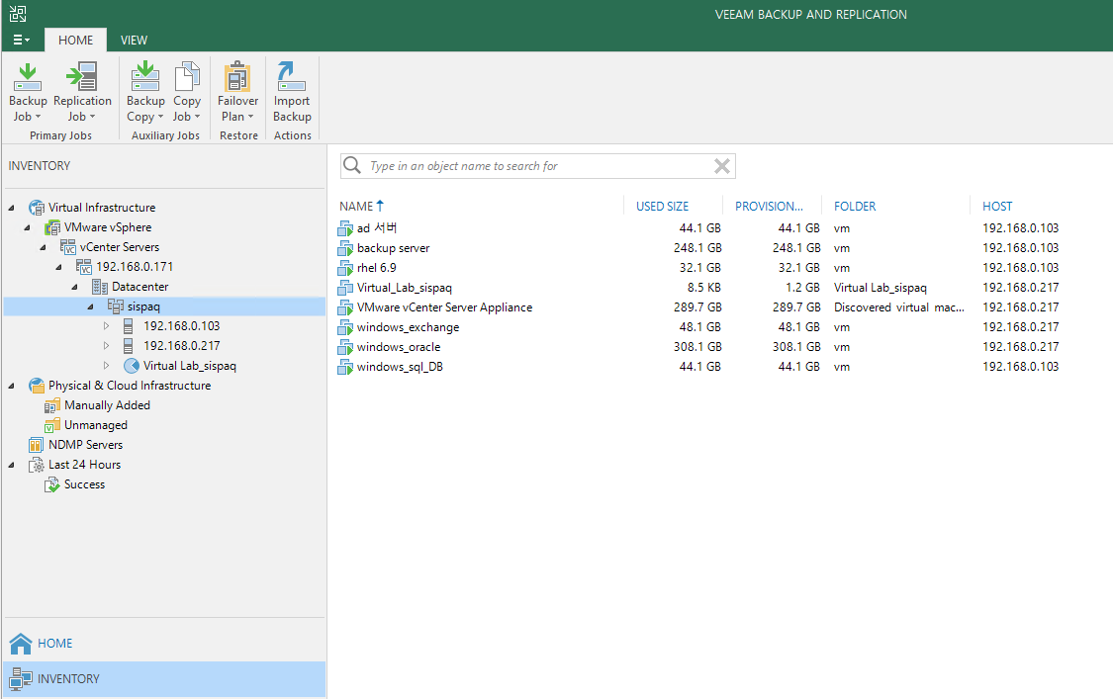
1. VMware Vsphere Backup
계정 정보 입력 후 VMware 환경에서 운영중인 VM list를 자동으로 탐색

Slide 22
2. Microsoft Hyper V Backup

Slide 23
2. Microsoft Hyper-V (VMware와 동일)
백업 Host 추가

Slide 24
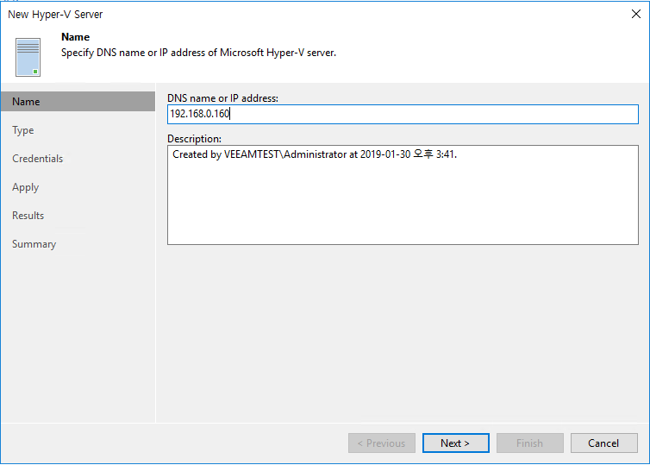
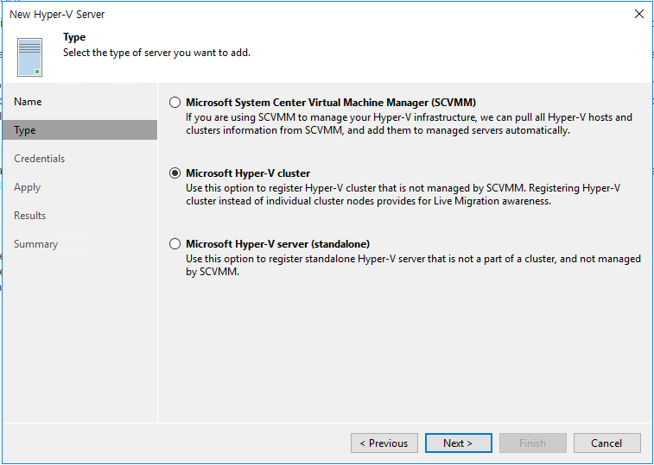
2. Microsoft Hyper-V
백업 Host 추가
대상 Host ip 입력
SCVMM, Cluster, Standalone

Slide 25
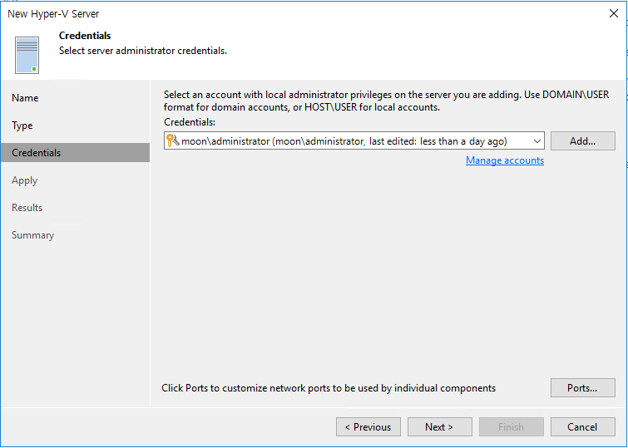
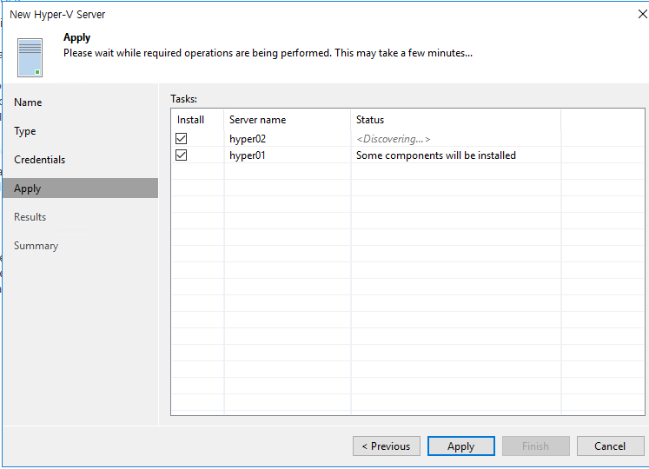
2. Microsoft Hyper-V
계정 정보 입력
Hyper-V 호스트

Slide 26
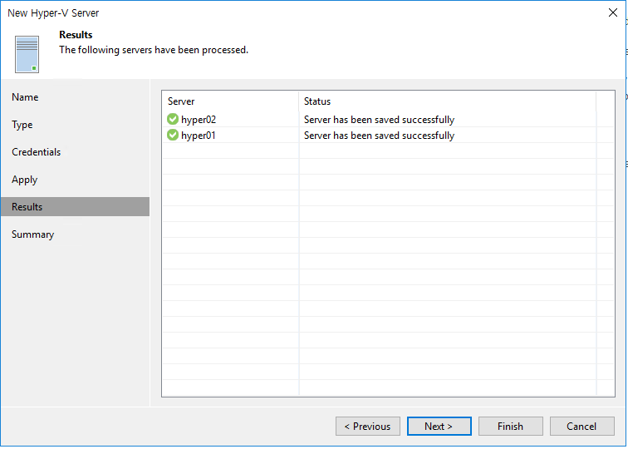
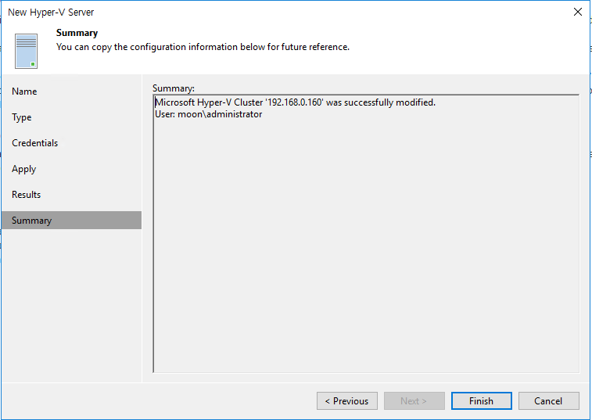
2. Microsoft Hyper-V

Slide 27
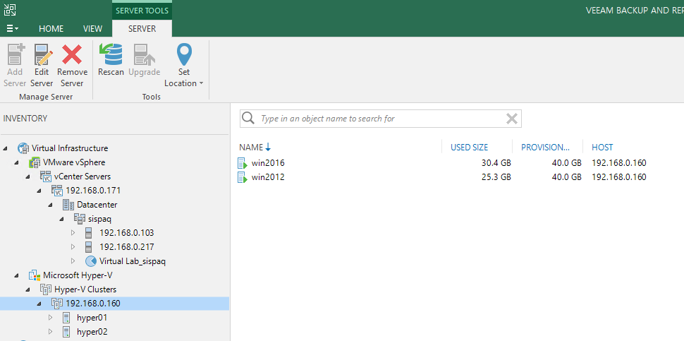
2. Microsoft Hyper-V
계정 정보 입력 후 Hyper-V 환경에서 운영중인 VM list를 자동으로 탐색

Slide 28
3. VMware, Hyper – V Backup Job 생성

Slide 29
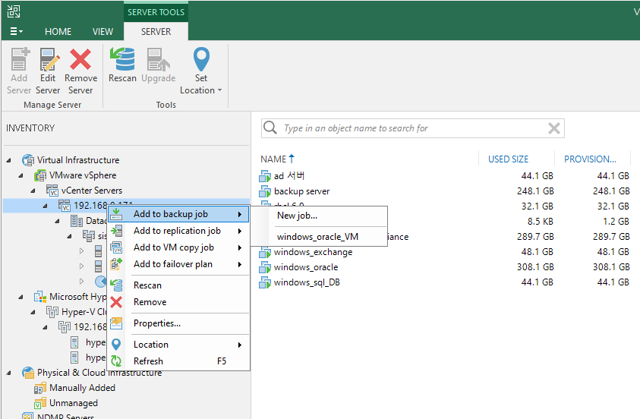
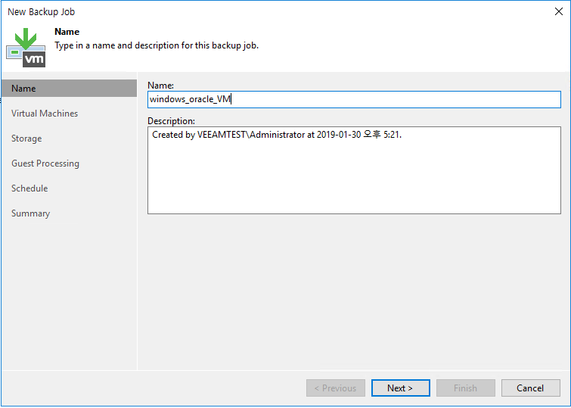
3. Backup Job 생성 – VMware, Hyper V 동일함
New job 생성 – 그룹단위 선택 가능
Job Name 생성

Slide 30
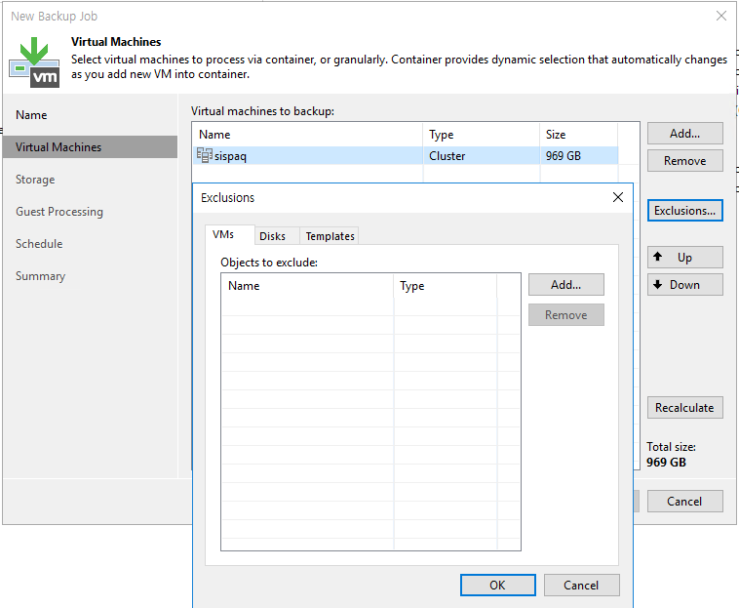
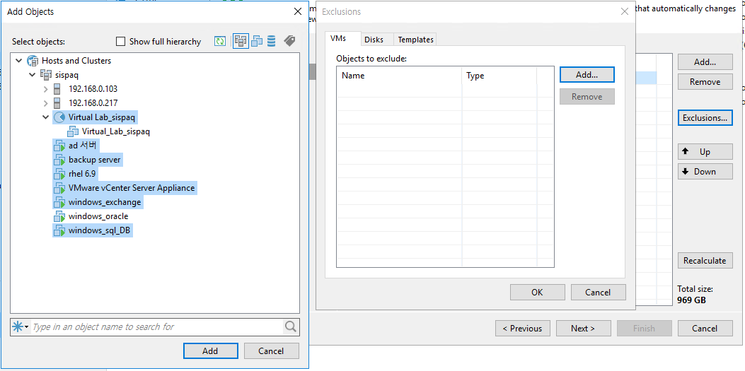
3. Backup Job 생성 – VMware, Hyper V 동일함
Backup VM 선택
Exclusions - 특정 VM 만 backup 받을 때 사용
Backup 에서 제외할 VM 선택가능

Slide 31
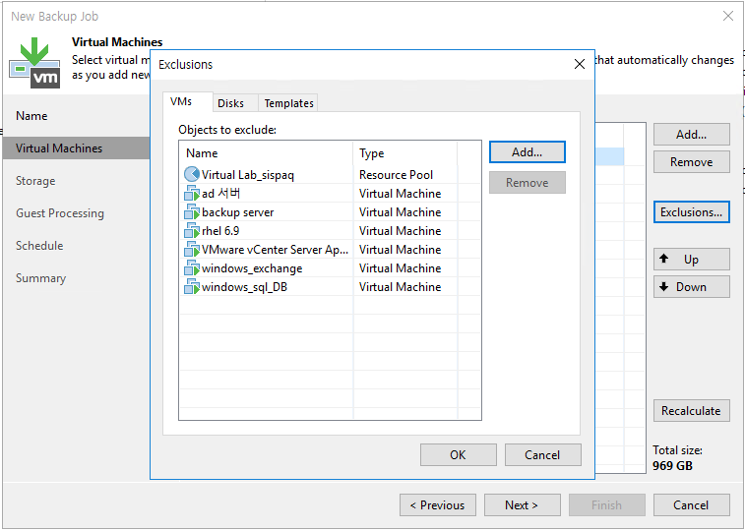
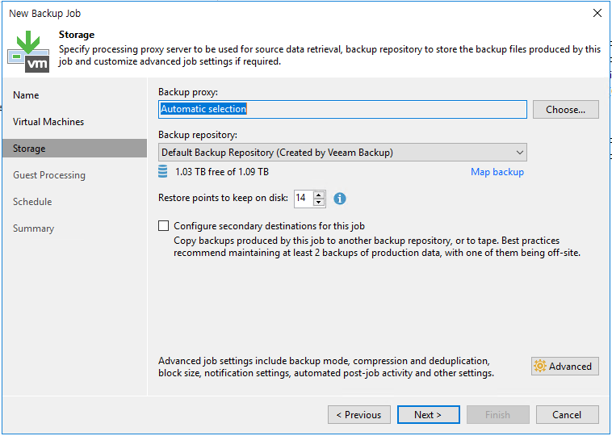
3. Backup Job 생성 – VMware, Hyper V 동일함
Backup repository 선택

Slide 32
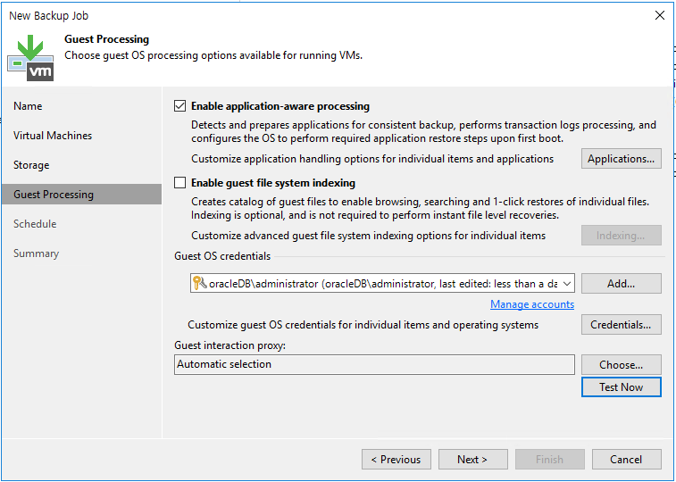
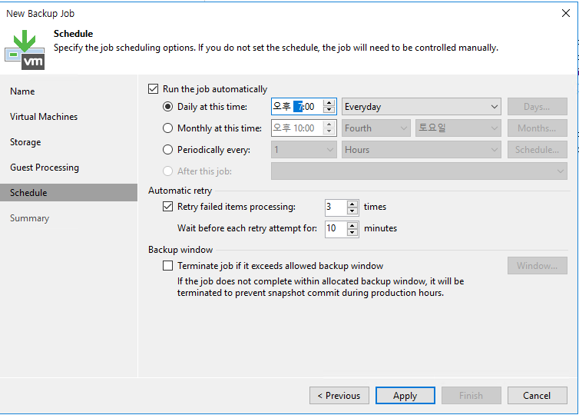
3. Backup Job 생성 – VMware, Hyper V 동일함
application-aware : DB 정합성 확인
Backup schedule

Slide 33
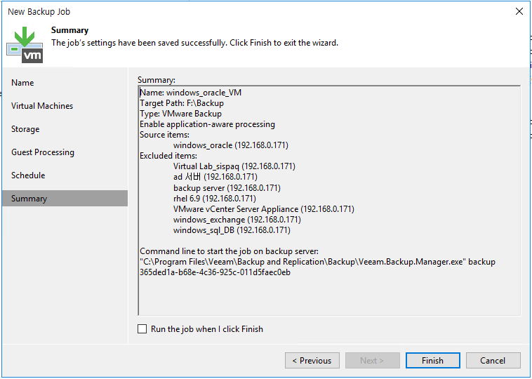
3. Backup Job 생성 – VMware, Hyper V 동일함

Slide 34
4. VMware, Hyper – V Backup Job 실행

Slide 35
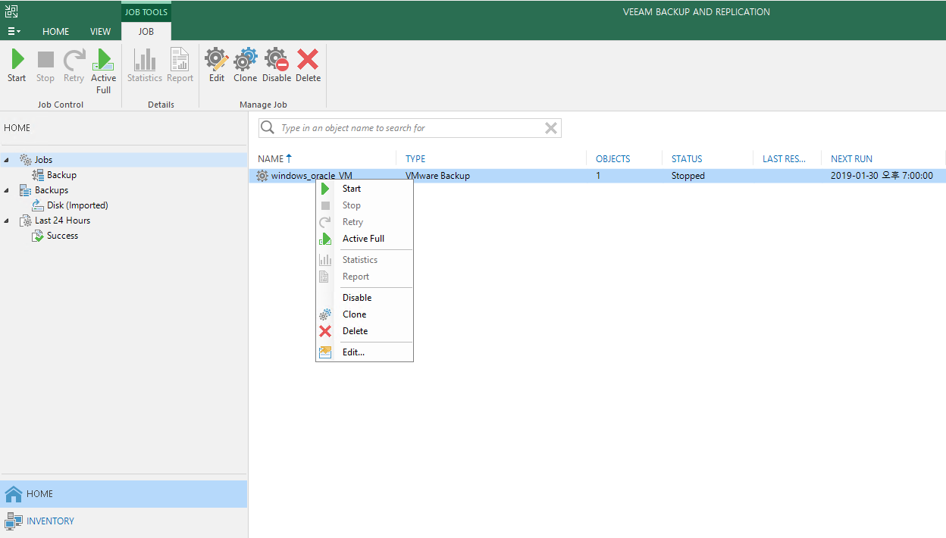
4. Backup 실행

Slide 36
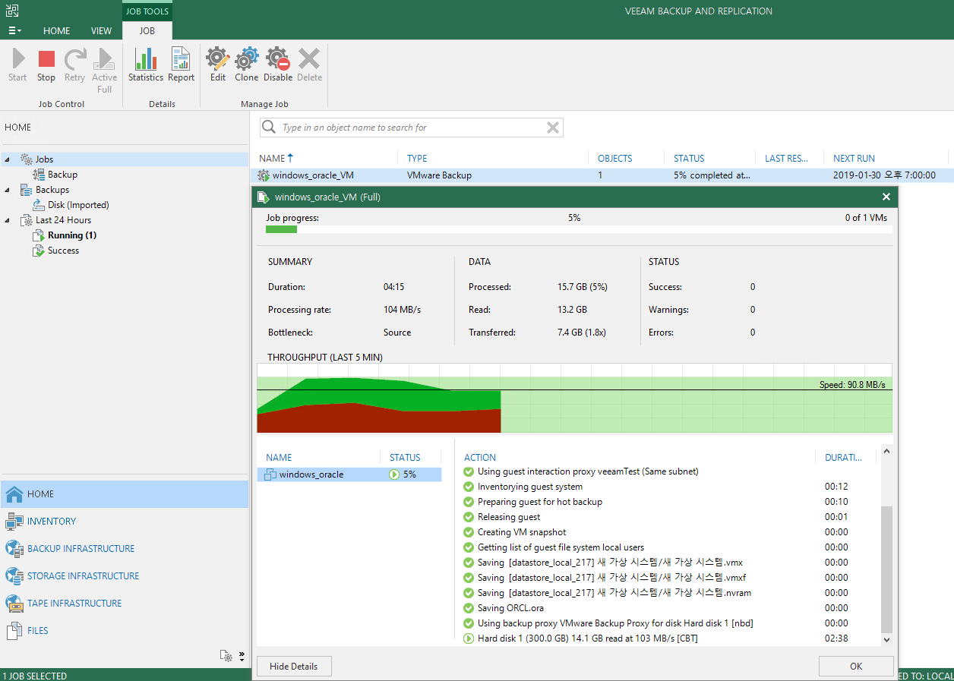
4. Backup Job 실행

Slide 37
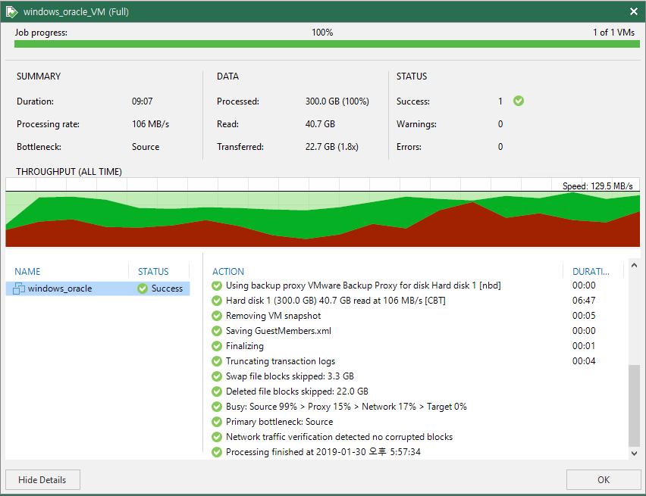
4. Backup Job 실행
SUMMARY, DATA, STATUS
Duration – backup 진행 시간
Transferred – backup data
Action – backup 진행 사항

Slide 38
5. VMware, Hyper – V Backup Restore

Slide 39
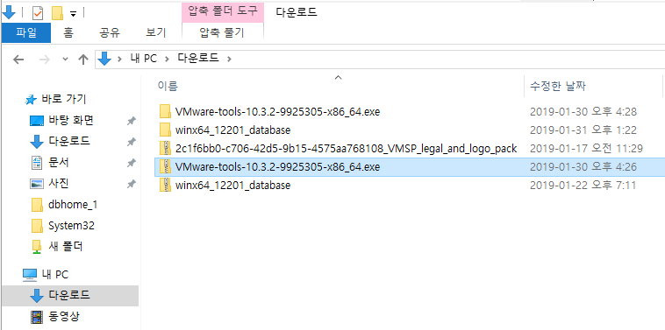
5. Backup Job Restore – File level
원본 서버 복구대상 파일

Slide 40
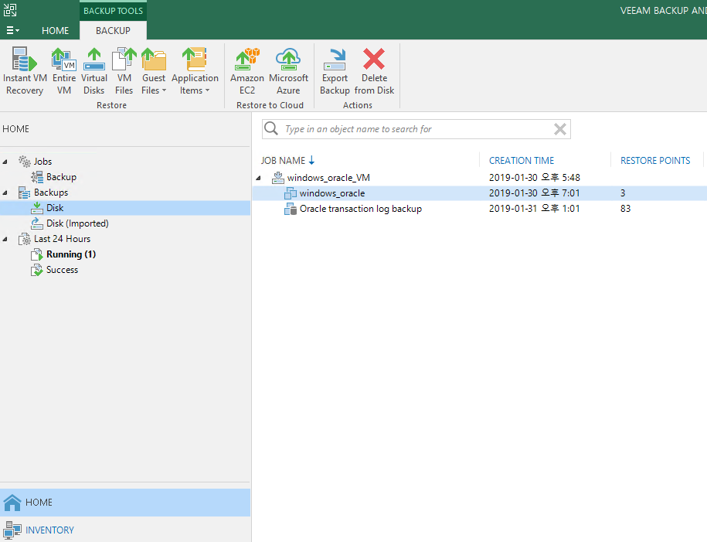
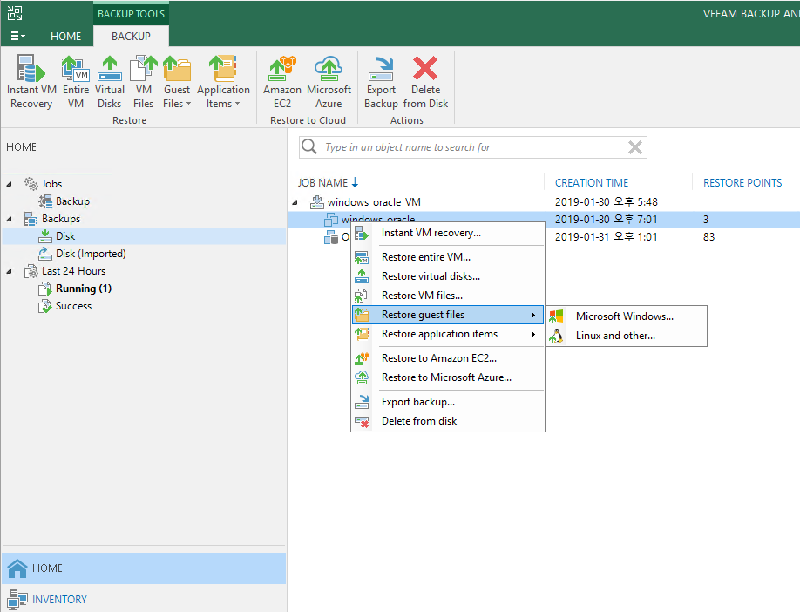
5. Backup Job Restore – File level
Disk 에서 Restore 대상 VM 선택

Slide 41
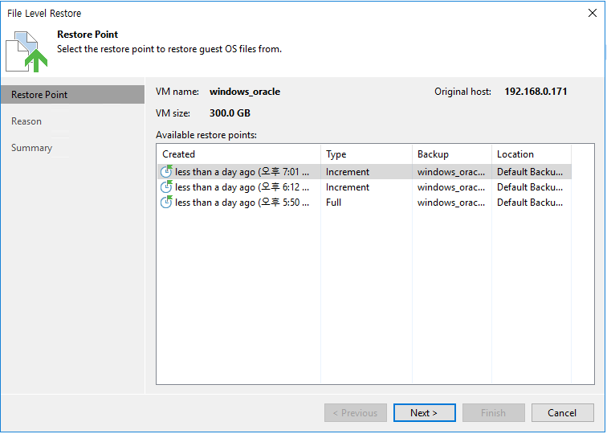
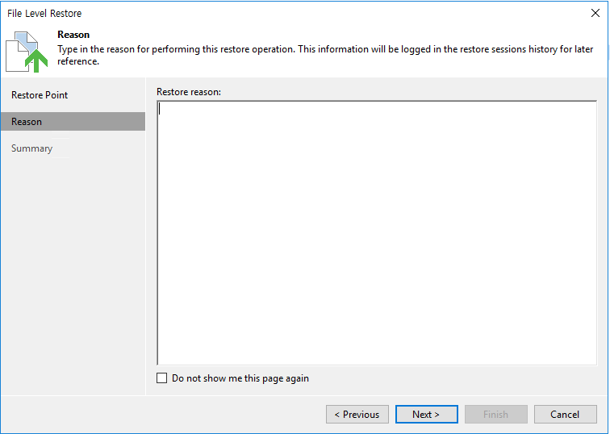
5. Backup Job Restore – File level
복구 시점 선택

Slide 42
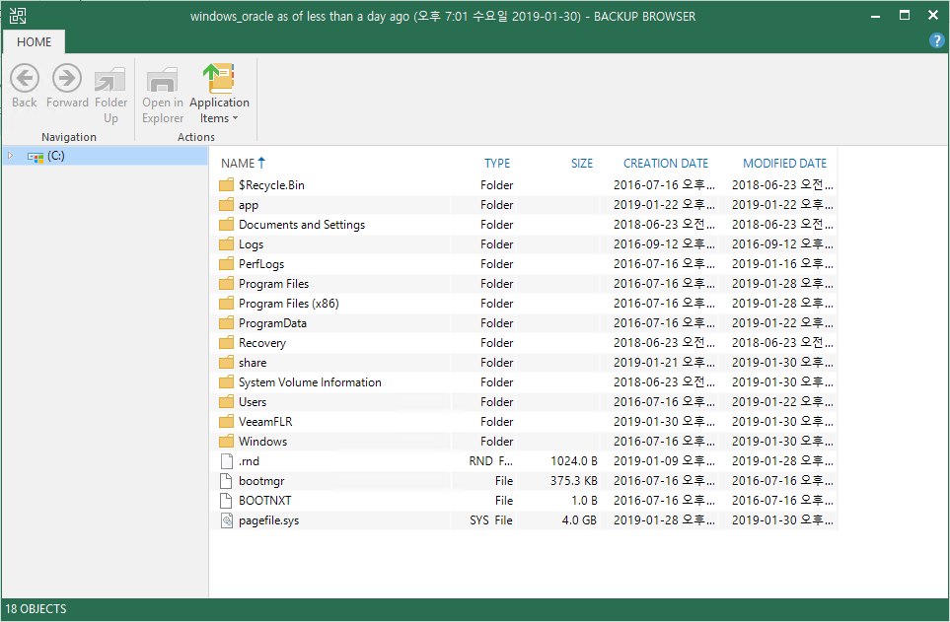
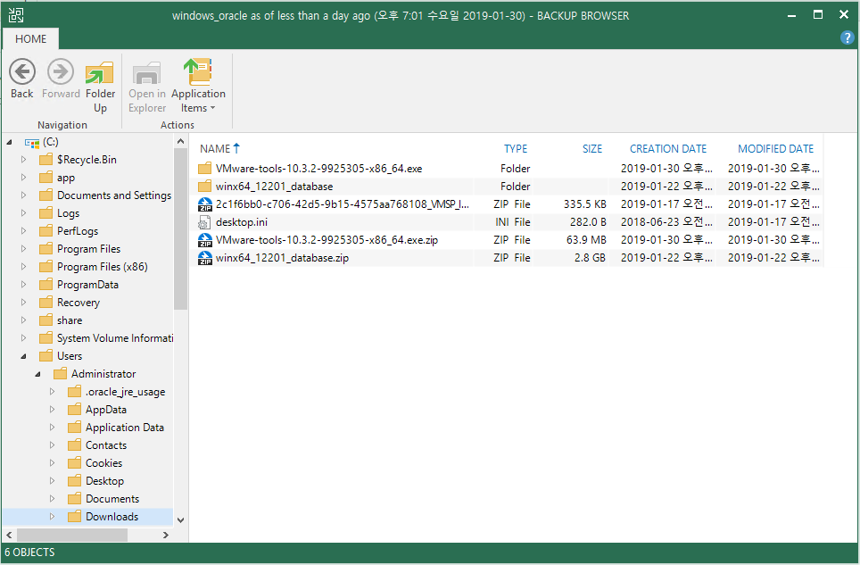
5. Backup Job Restore – File level
원본 서버 복구대상 파일
복구 대상 파일 선택

Slide 43
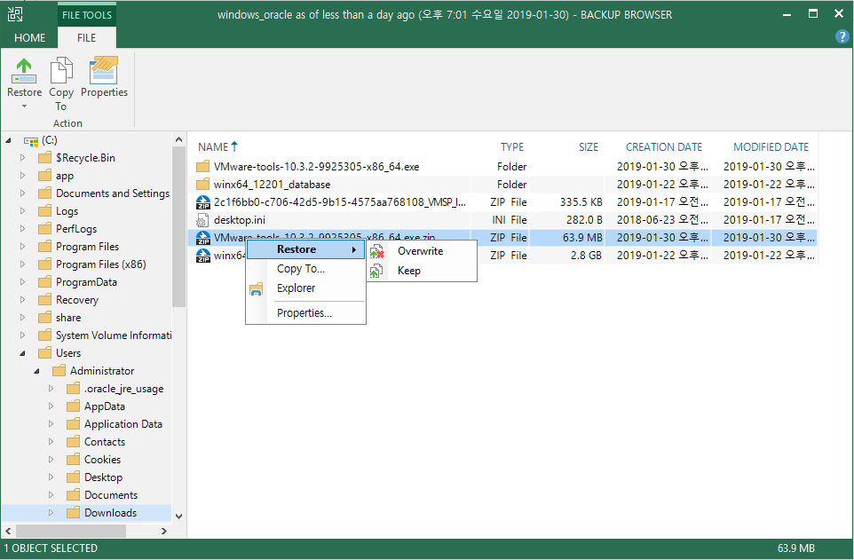
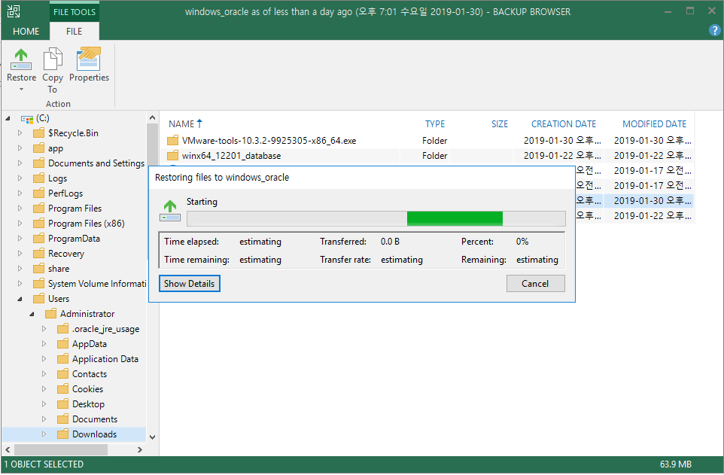
5. Backup Job Restore – File level
Restore Overwrite – 덮어쓰기
Restore keep – 복구 대상 파일 보호, 복구는 Restore_파일 이름으로 복구됨

Slide 44
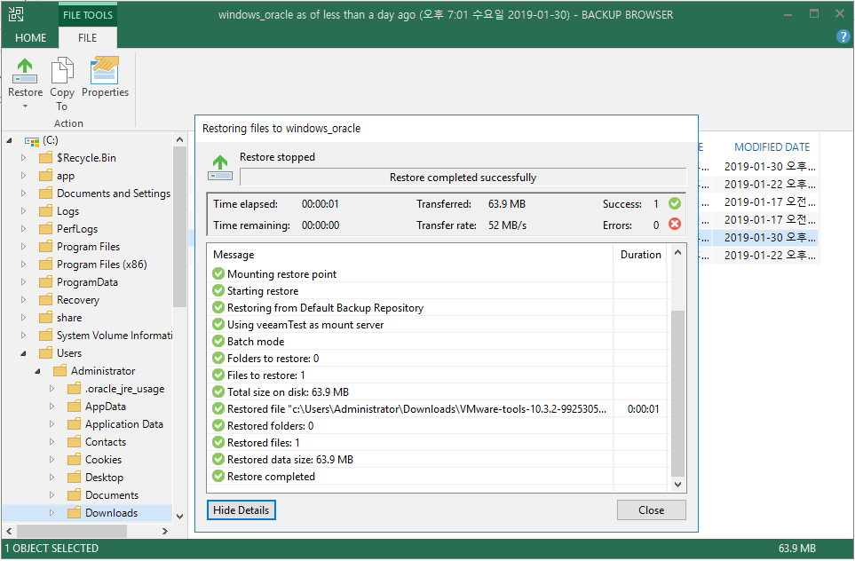
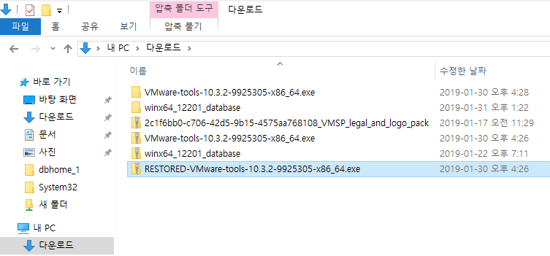
5. Backup Job Restore – File level
원본 서버 복구 완료

Slide 45
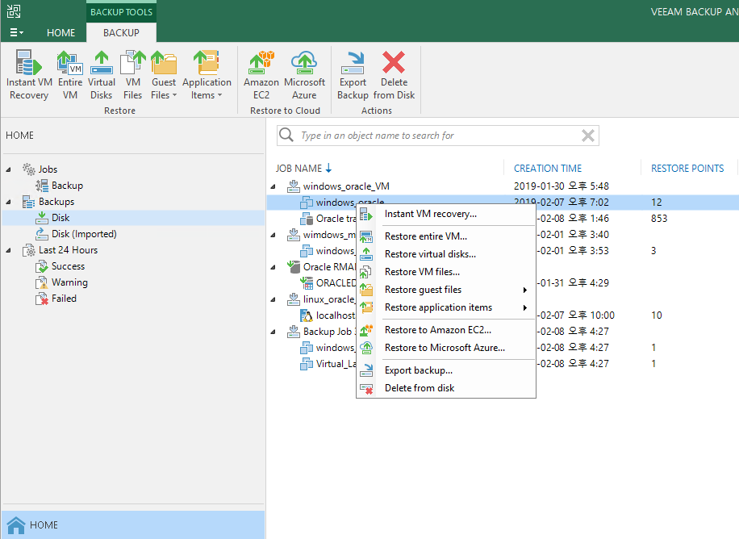
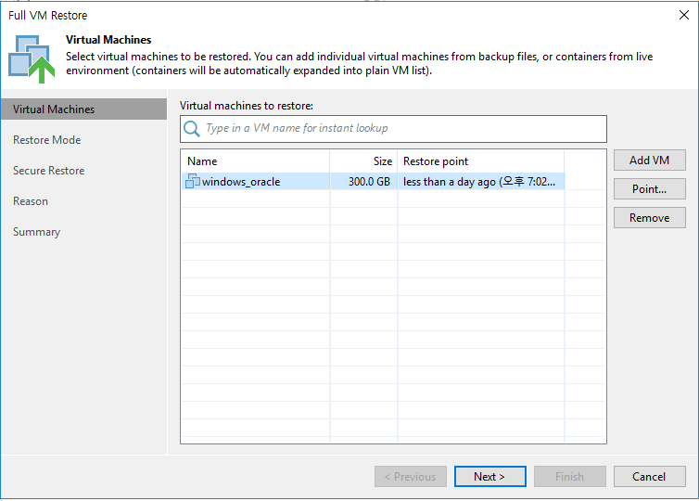
5. Backup Job Restore – Entire VM
VM 전체 복구

Slide 46
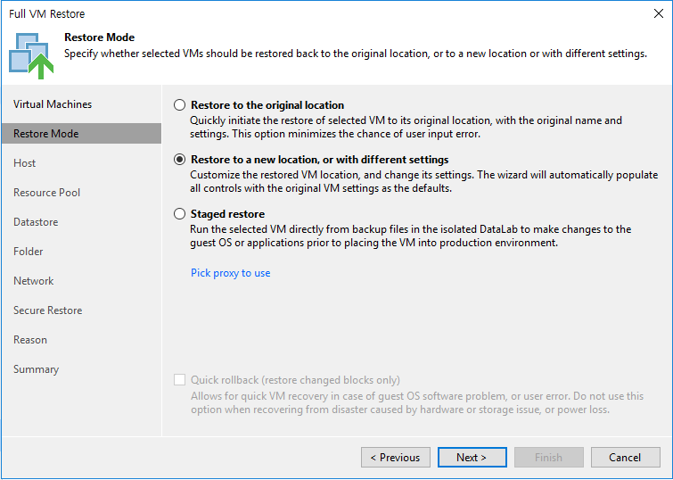
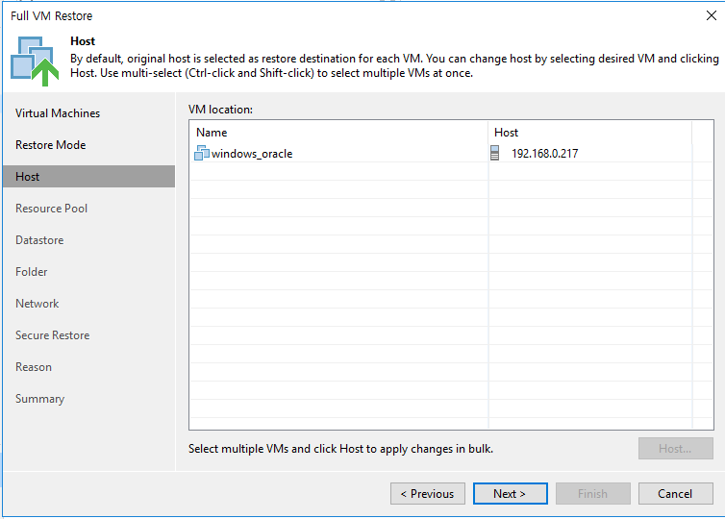
5. Backup Job Restore – Entire VM
VM 복구 대상(HOST 선택) – original, different host

Slide 47


5. Backup Job Restore – Entire VM

Slide 48


5. Backup Job Restore – Entire VM
VM 이름 변경
네트워크 선택

Slide 49


5. Backup Job Restore – Entire VM

Slide 50


5. Backup Job Restore – Entire VM
Entire VM restore 완료

Slide 51
6. Replication

Slide 52


6. Replication – Job 생성
Replication VM 선택 후 Job 생성
Bandwidth, Network remapping, re-IP 환경에 맞는 적절한 옵션 선택

Slide 53


6. Replication – Job 생성
Replication 대상 VM 선택
Destination Host 선택

Slide 54


6. Replication – Job 생성
Replication 대상 VM 선택
VM 이름, Restore point 수정

Slide 55


6. Replication – Job 생성
Data Transfer – Direct, WAN accelerators
DB에 따라 정합성 유무 체크

Slide 56


6. Replication – Job 생성
Replication Schedule
Replication Job 생성 완료

Slide 57

6. Replication – Job 실행
Home > Replication 탭에서 Replication 실행

Slide 58

6. Replication – Job 실행
Replication 실행 후 DR HOST 에서 win2012_replica VM 생성됨

Slide 59

6. Replication – Job 실행
Replication 작업 진행 중

Slide 60

6. Replication – Job 실행
Replication 작업 진행 완료

Slide 61

6. Replication – Failover Test
Replication 완료 후 Home > Replicas 탭에서 실행
Failover Now
Planned Failover

Slide 62


6. Replication – Failover Test
Failover VM, point 선택
완료

Slide 63

6. Replication – Failover Test
Failover 완료 후 VM Booting 완료

Slide 64
7. SureBackup

Slide 65

7. SureBackup – Application Group
Application Group > Virtual Lab > SureBackup Job 진행

Slide 66


7. SureBackup – Application Group
Application Group 생성

Slide 67



7. SureBackup – Application Group
Application Group Verification – Role, Startup Option

Slide 68


7. SureBackup – Virtual Lab
Host에 가상의 Virtual Lab VM 생성

Slide 69



7. SureBackup – Virtual Lab
Hyper-V Host에 생성된 Virtual Lab VM
vCpu 1ea, Memory 1G
Hyper-V Host에 가상의 Virtual Lab VM 생성

Slide 70
7. SureBackup – Virtual Lab
Hyper-V Host에 생성된 Virtual Lab VM
vCpu 1ea, Memory 1G
Hyper-V Host에 가상의 Virtual Lab VM 생성

Slide 71


7. SureBackup – Virtual Lab
Virtual Lab VM IP 설정

Slide 72


7. SureBackup – Virtual Lab
Virtual Lab VM IP 설정

Slide 73



7. SureBackup – Virtual Lab

Slide 74


7. SureBackup – SureBackup Job

Slide 75


7. SureBackup – SureBackup Job
생성한 Virtual Lab VM, Application group 선택

Slide 76


7. SureBackup – SureBackup Job
Application group 및 Jobs 선택

Slide 77



7. SureBackup – SureBackup Job
File integrity, Malware scan

Slide 78


7. SureBackup – SureBackup Job
SureBackup Job 실행

Slide 79

7. SureBackup – SureBackup Job
SureBackup Job 실행 후 Hyper V Host에 Virtual_Lab VM 생성됨

Slide 80

7. SureBackup – SureBackup Job

Slide 81

7. SureBackup – SureBackup Job

Slide 82


7. SureBackup – SureBackup Job
SureBackup Job 완료

Slide 83
Thank you

